Slide 5
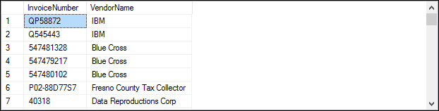

Slide 7


Slide 8


Slide 9


Slide 12
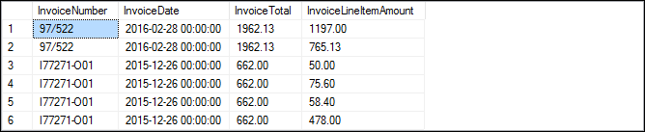

Slide 14
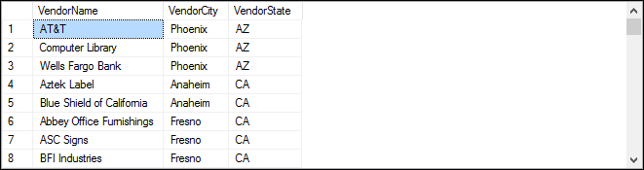

Slide 16
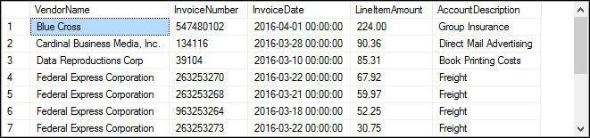

Slide 17
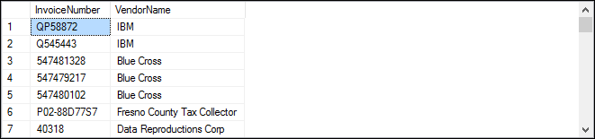

Slide 18


Slide 21
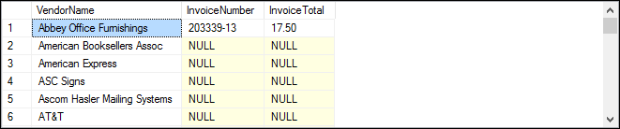

Slide 22
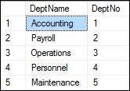
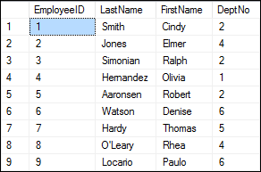
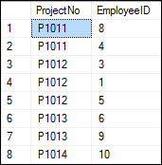

Slide 23
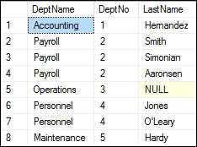

Slide 24
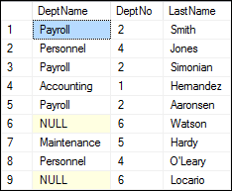

Slide 25
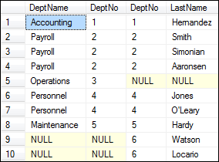

Slide 26
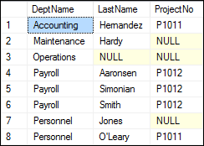

Slide 27
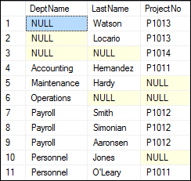

Slide 28
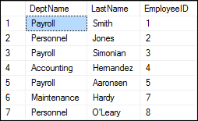
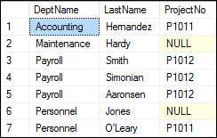

Slide 31
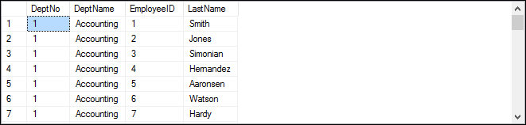

Slide 34
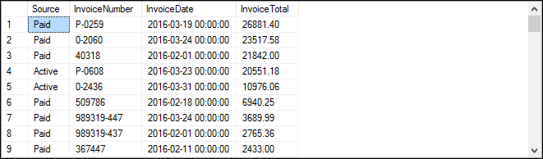

Slide 35
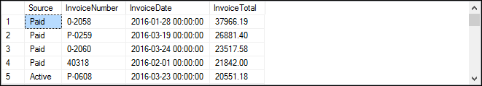

Slide 37


Slide 38
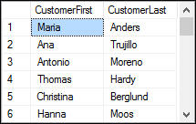
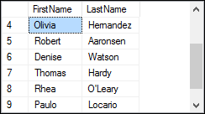

Slide 39
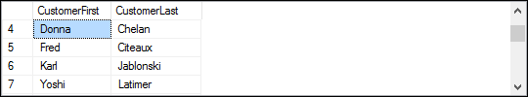

Slide 42
The logical Query Processing Phases:
What sets SQL Server apart from other programming languages is the way it processes its code. Generally, most programming languages process statement from top to bottom. But in contrast, SQL Server processes them in a unique order which is known as Logical Query Processing Phase. These phases generate a series of virtual tables with each virtual table feeding into the next phase (virtual tables are not viewable).
1. FROM
2. ON
3. OUTTER
4. WHERE
5. GROUP BY
6. CUBE | ROLLUP
7. HAVING
8. SELECT
9. DISTINCT
10. TOP
11. ORDER BY

